Slide 1
Digital Health-eMpower in Vihaan
Helping Improve The Quality Of Life Of People Living with HIV in India
Visvanathan Arumugam
India HIV/AIDS Alliance, New Delhi, India
AIDS 2018 – Community workshop - 25th July 2018 – 14:30 to 17:00
In search of the fourth 90: exploring and defining what quality of life means for communities and strategizing how we get there

Slide 2
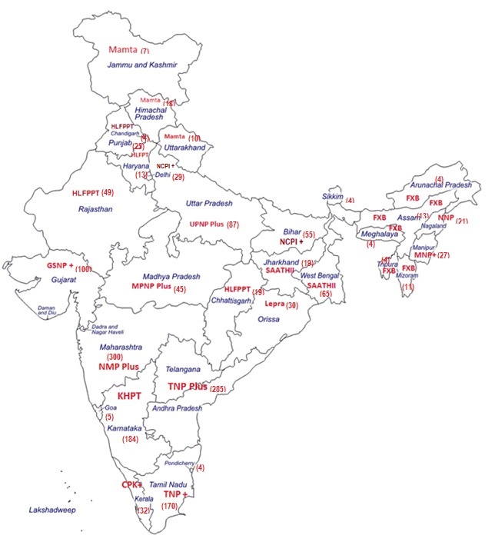


Improving quality of life and survival of people living with HIV (PLHIV)
Home based care services
Linkages and referral services- Health and non-health services
Lost to follow-up/Missed cases tracking and bringing back to treatment.
Partner testing
Tuberculosis (TB) screening
Counselling
20 sub recipients and 392 sub-sub recipients (80% PLHIV networks) covering 32 states and territories.
1.27 million PLHIV in ART care

Slide 3


Key challenges
High case load
Paper load
Illiteracy
Confidentiality
Linking
clients
Data & Analytics

Slide 4
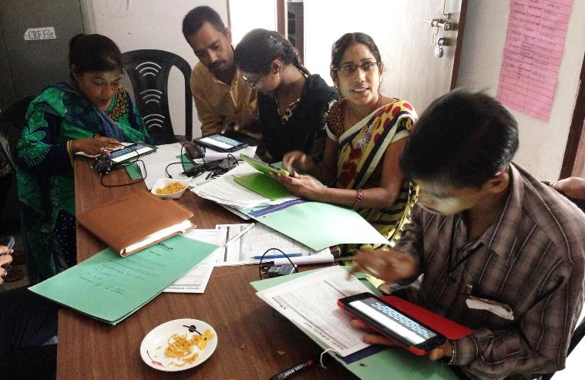
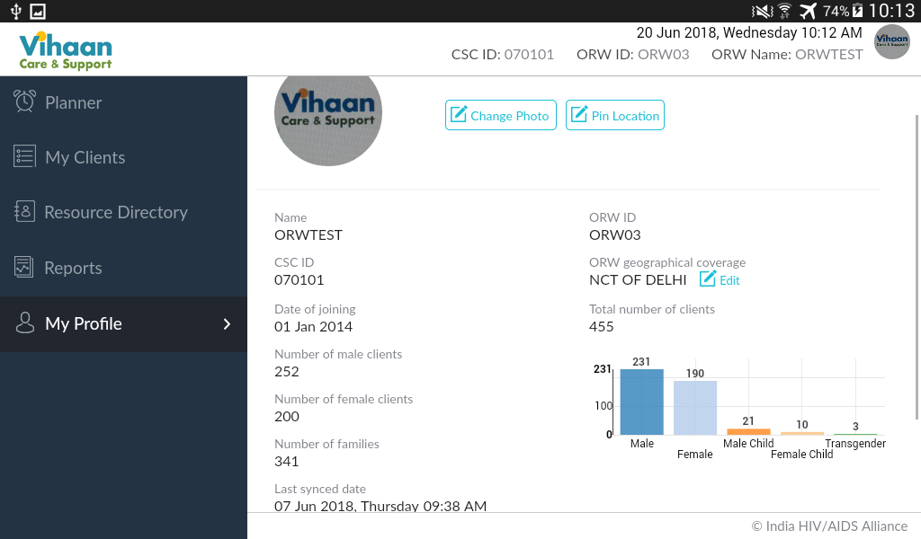
eMpower- Vihaan Tablet client-management application
Goal
To ensure treatment adherence and increase in service uptake to better health outcome and quality of life of PLHIV.
Objectives
To ensure effective outreach through client prioritisation.
To monitor client’s health regularly and provide follow up service.
On-site advocacy tool
Method
Offline data entry and GIS activated client location tracking
Data update through offline data entry option which will be synchronised with Vihaan Central Management Information System (CMIS).
Beneficiary
Community Outreach staff (approximately 1857 community champion ORWs working in the programme)
1.2 million PLHIV and their family members registered

Slide 5
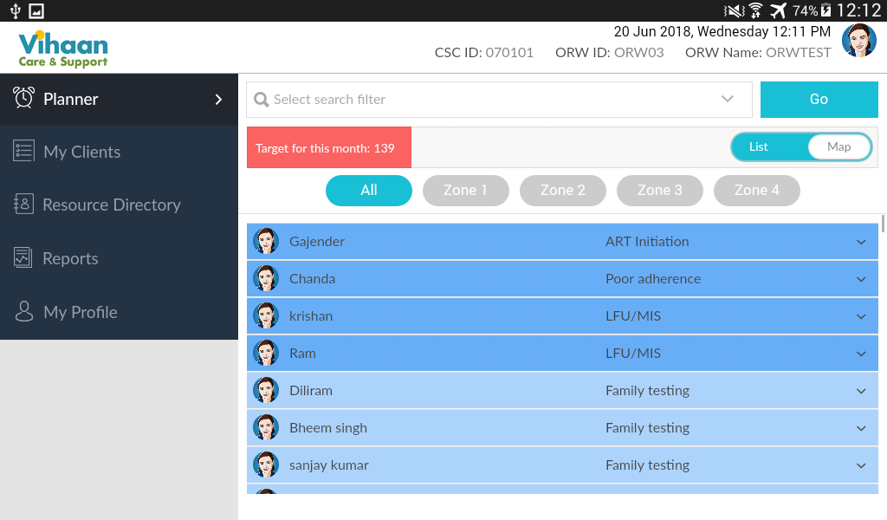

Tracking & managing based on priorities

Slide 6
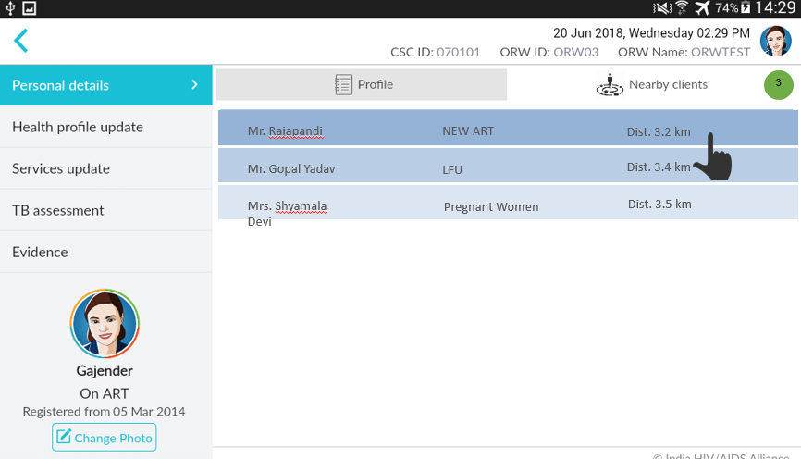
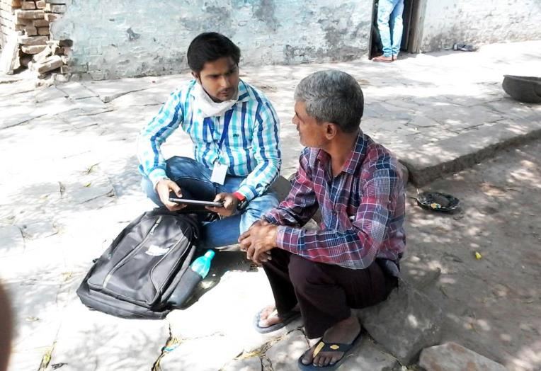
Tracking & managing based on priorities (Contd.)

Slide 7
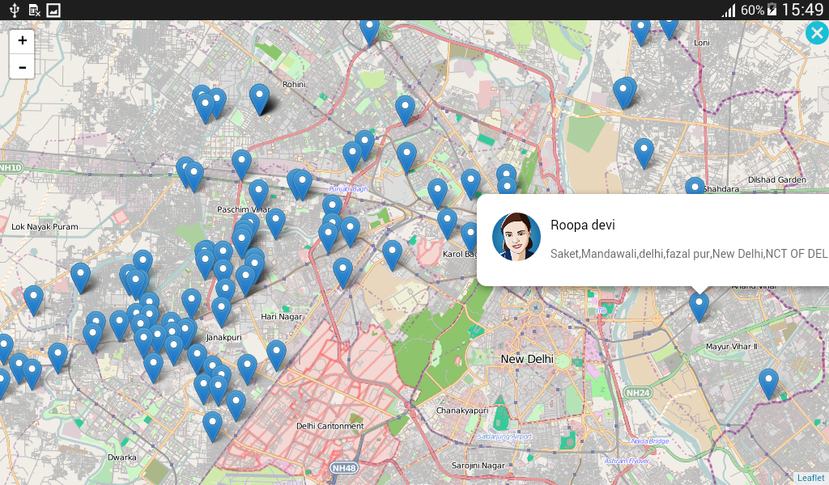
Geo navigation to increase efficiency in delivering services

Slide 8
Outcomes

Slide 9
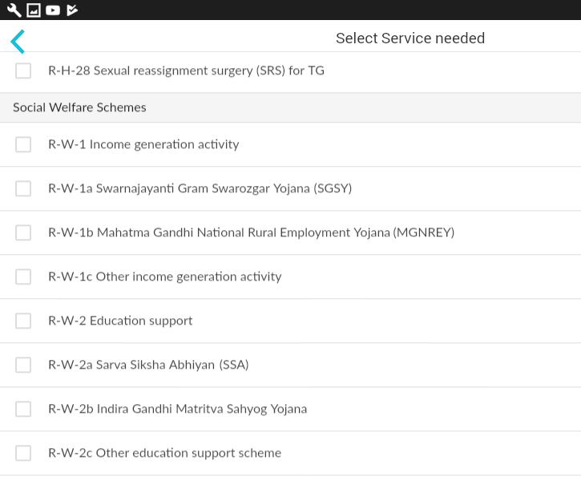
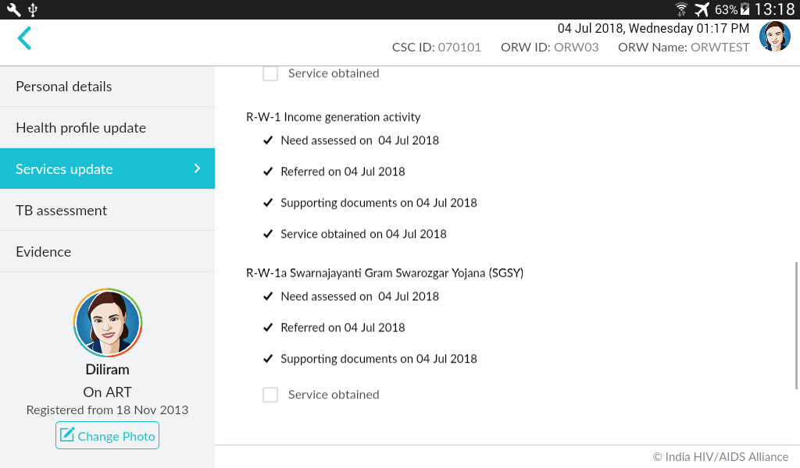
Financial Independence through Social Protection Linkages
  593,737 PLHIVs who are in need of some social protection were linked with the respective departments/services
  35% are being supported for nutritional schemes.
  25% are being supported for pension schemes which gives monthly remuneration.
  Skill building support: 2,248 candidates attended the skill building orientation sessions, of which 267 candidates trained and on process of placement

Slide 10
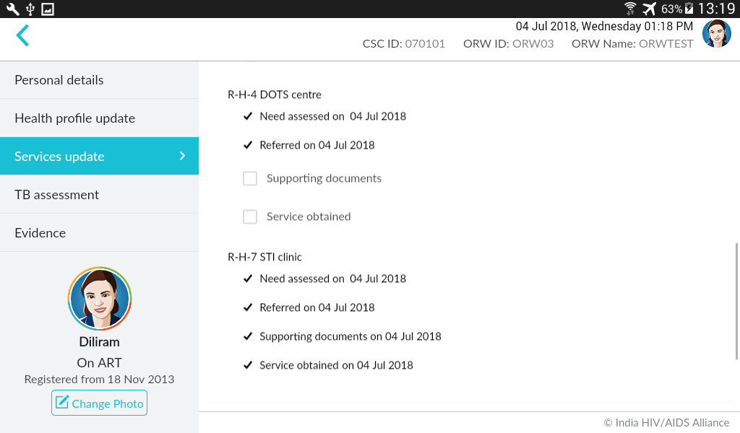
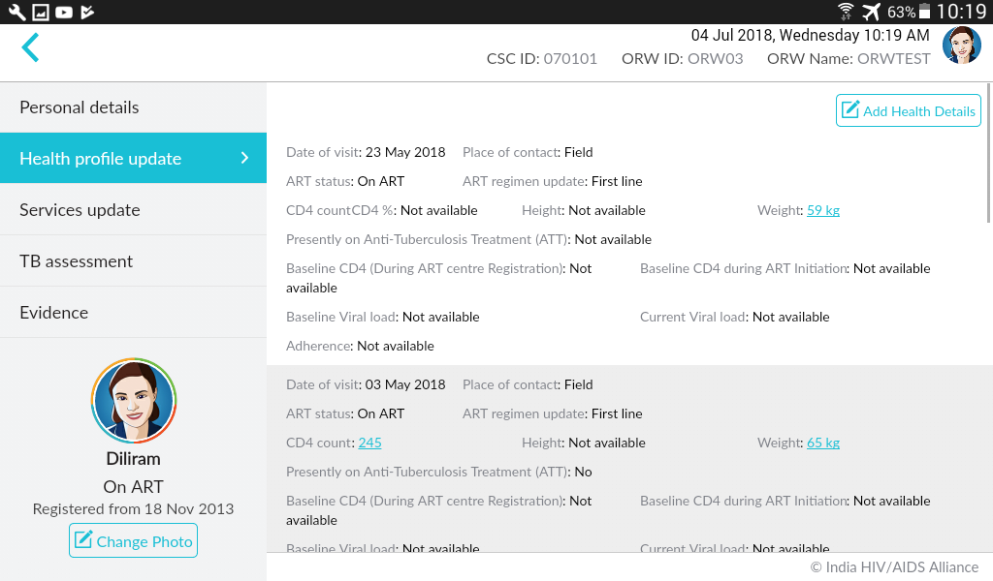
Increased retention in care through Counselling and health linkages
203,897 for the PLHIV clients for non-health service which include prevention, counselling, life skills, livelihood options
1,272,483 referrals (84% of total registered) linked with Health services of which 52% referral were to the ART center.
144,914, partners and family members HIV testing testing Health profile of PLHIV monitoring- CD4 and ART status

Slide 11
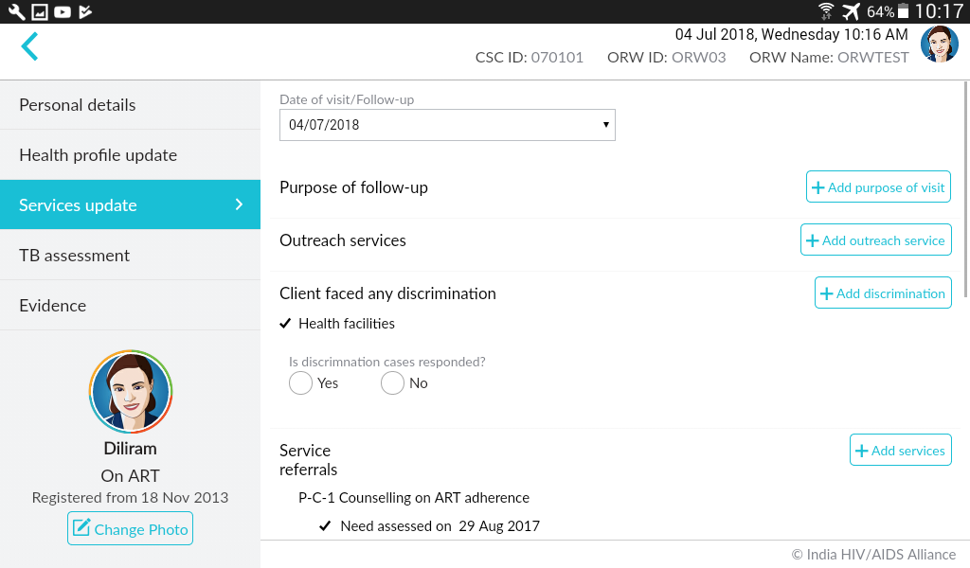
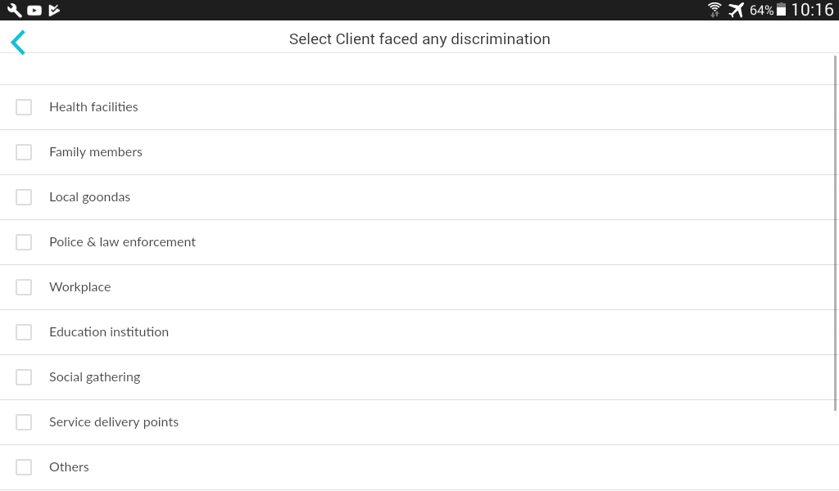
Supporting to manage stigma and discrimination
6,136 discrimination cases has been reported and responded
Predominantly, 58% of discrimination was faced from family members.
18% of discrimination from the health care facilities (Government / Private).

Slide 12
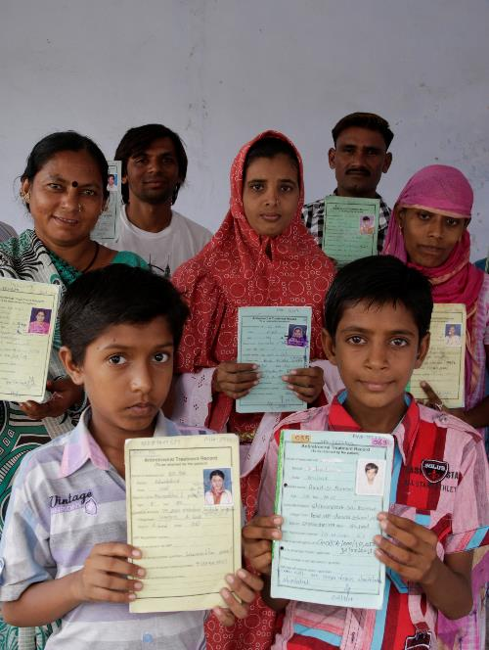
Summary
Increased efficiency of community led outreach services
1,143,438 active clients (89% of total PLHIV registered at ART centres) in care and support centres
1,312 clients’ family members have been identified and referred for HIV testing every month since January 2017 (in comparison to 453 monthly average for three years before tablet implementation).
1,003,137 screened for TB every month since January 2017 (68,884 in comparison to 13,318 monthly average for one year before tablet implementation).
Towards 90:90:90
First 90: 144,914 family members tested for HIV testing and 10,547 found positive
Second 90: 10,505 PLHIV linked and initiated on ART
Third 90: 489,690 lost to follow up cases tracked and returned to ART centers.
Increased health outcome:
149,976 were tested for TB and 10,075 TB positive PLHIVs linked for treatment
Increased CD4 among the PLHIV who received care and support services

